Slide 1

Pretty Good Privacy (PGP)

Slide 2
Pretty Good Privacy (PGP)
PGP is a remarkable phenomenon. Largely the effort of a single person, Phil Zimmermann, PGP provides a confidentiality and authentication service that can be used for electronic mail and file storage applications. a fully
compatible, low-cost commercial version of PGP.
Notes:
Public-Key Distribution Algorithms

Slide 3
Pretty Good privacy (PGP)
PGP has grown explosively and is now widely used. A number of reasons can be cited for this growth:
1. It is available free worldwide in versions that run on a variety of
platforms.
2. It is based on algorithms that have survived extensive public review
and are considered extremely secure. Specifically, the package
includes RSA, DSS, and Diffie-Hellman for public-key encryption;
CAST-128, IDEA, and 3DES for conventional encryption; and
SHA-1 for hash coding.
3. It has a wide range of applicability, from corporations that wish to
select and enforce a standardized scheme for encrypting files and
message to individuals who wish to communicate securely with
others worldwide over the Internet and other networks.
4. It was not developed by, nor is it controlled by, and governmental
or standards organization. For those with an instinctive distrust of
“the establishment,” this makes PGP attractive.

Slide 4
Notation
Ks = session key used in conventional encryption scheme
KRa = private key of user A, used in public-key encryption scheme
KUa = public key of user A, used in public-key encryption scheme
EP = public-key encryption
DP = public-key decryption
EC = conventional encryption
DC = conventional decryption
H = Hash function
|| = concatenation
Z = compression using ZIP algorithm
R64 = conversion to radix 64 ASCII format

Slide 5
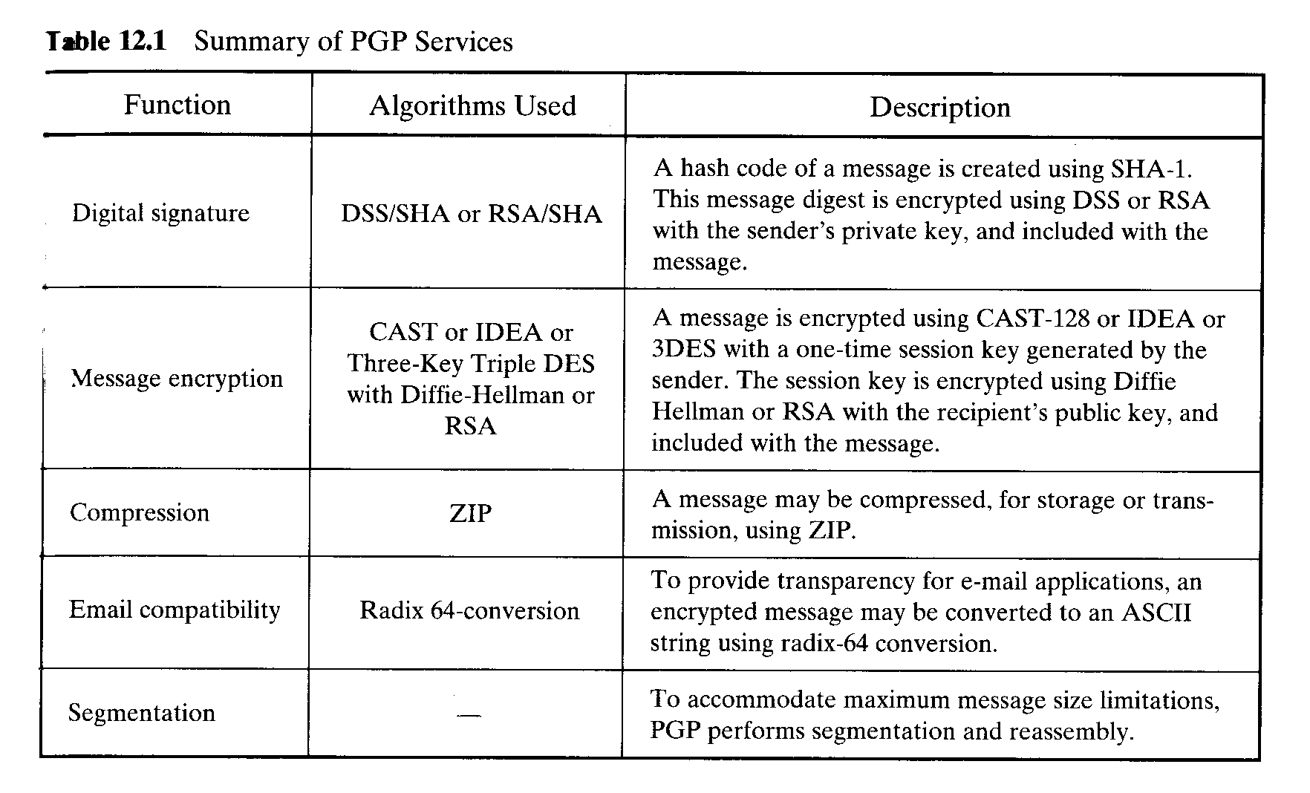
Operational Description
The actual operation of PGP, as opposed to the management of keys consists of five services: authentication, confidentiality, compression, e-mail compatibility, and segmentation.

Slide 6
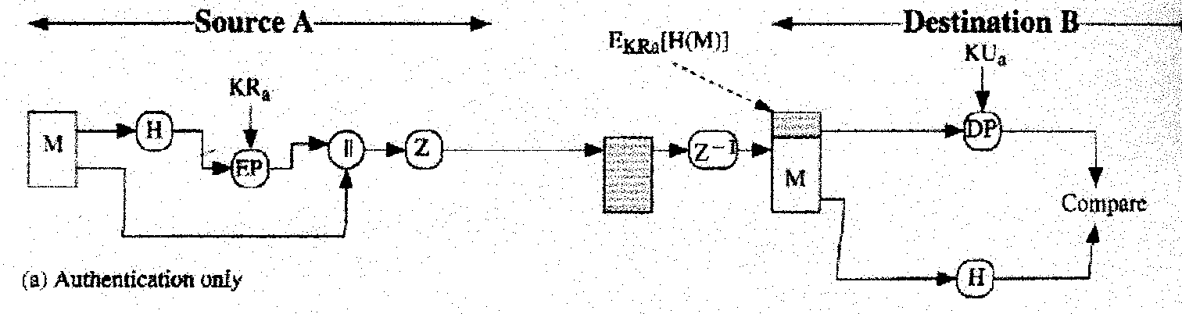
Authentication
The figure illustrates the digital signature service provided by PGP. The sequence is as following:
1. The sender creates a message.
2. SHA-1 is used to generate a 160-bit hash code of the message.
3. The hash code is encrypted with RSA using the sender’s private key, and
the result is prepended to the message.
4. The receiver uses RSA with the sender’s public key to decrypt and recover.
the hash code.
5. The receiver generates a new hash code for the message and comares it
with the decryption hash code. If the two match, the message is accepted as
authentic.

Slide 7
Authentication
The combination of SHA-1 and RSA provides an effective digital signature scheme. Because of the strength of RSA, the recipient is assured that only the possessor of the matching private key can generate the signature. Because of the strength of SHA-1, the recipient is assured that no one else could generate a new message that matches the hash code.
As an alternative, signatures can be generated using DSS/SHA-1.
Although, signatures normally are found attached to the message or file that they sign, this is not always the case: Detached signatures are supported. A detached signature may be stored and transmitted separately from the message it signs. This is useful in several context. A user may wish to maintain a separate signature log of all messages sent or received. A detached signatures of an executable program can detect subsequent virus infection. Finally, detached signatures can be used when more than one party must sign a document, such as a legal contract. Each person’s signature is independent and therefore is applied only to the document. Otherwise, signatures would have to be nested, with the second signer signing both the document and the first signature, and so on.

Slide 8
Confidentiality
Another basic service provided by PGP is confidentiality, which is provided by encrypting messages to be transmitted or to stored locally as files. In both cases, the conventional encryption algorithm CAST-128 may be used. Alternatively, IDEA or 3DES may be used. The 64-bit cipher feedback mode is used.
As always, one must address the problem of key distribution. In PGP, each conventional key is used only once. That is, a new key is generated as a random 128-bit number for each message. Thus, although this is referred to in the documentation as a session key, it is in reality a one-time key. Because it is to be used only once, the session key is bound to the message and transmitted with it. To protect the key, it is encrypted with the receiver’s public key. The figure illustrates the sequence, which can be described as follows:

Slide 9
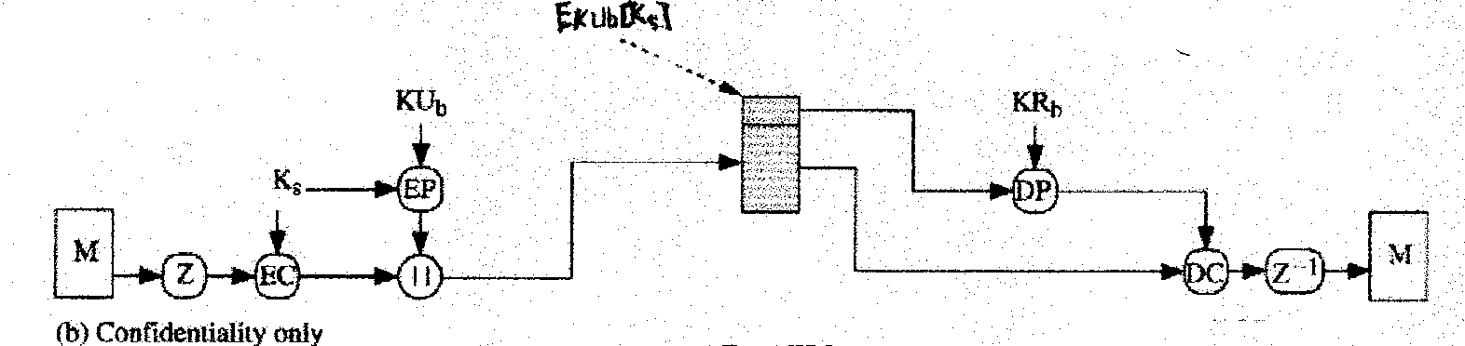
Confidentiality
1. The sender generates a message and a random 128-bit number
to be used as a session key for this message only.
2. The message is encrypted, using CAST-128 with the session key.
3. The session key is encrypted with RSA, using the recipient’s
public key, and is prepended to the message.
4. The receiver uses RSA with its private key to decrypt and
recover the session key.
5. The session key is used to decrypt the message.

Slide 10
Confidentiality
As an alternative to the use of RSA for key encryption, PGP provides an option referred to as Diffie-Hellman. PGP uses a variant og Diffie-Hellman that does provide encryption/decryption, known as ElGamal.
Several observation may be made. First, to reduce encryption time the combination of conventional and public-key encryption is used in preference to simply using RSA or ElGamal to encrypt the message directly: CAST-128 and the other conventional algorithms are substantially faster than RSA or ElGamanl. Second, the use of the public-key algorithm solves the session key distribution problem, because only the recipient is able to recover the session key that is bound to the message. Finally, the use of one-time conventional keys strengthens what is already a strong conventional encryption approach. Only a small amount of plaintext is encrypted with each key, and there is no relationship among the keys.

Slide 11
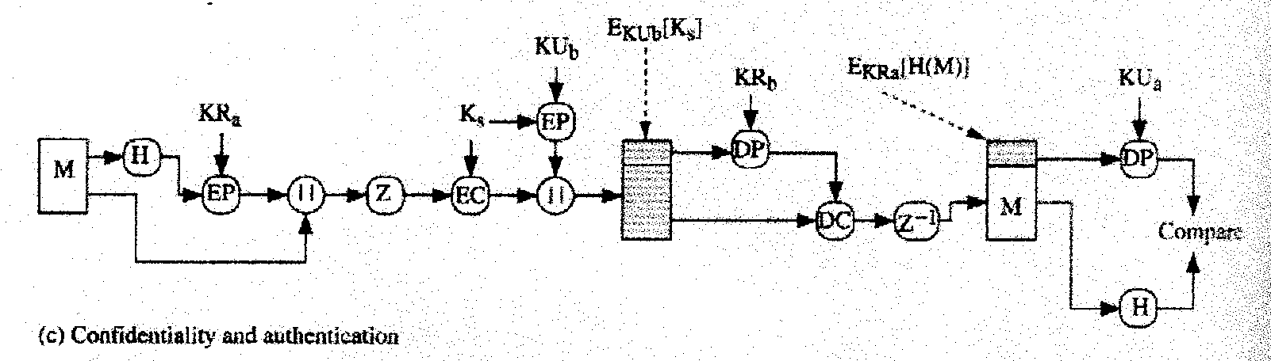
Confidentiality and Authentication
Figure illustrates, both services may be used for the same message. First, a signature is generated for the plaintext message and prepended to the message. Then the plaintext message plus signature is encrypted using CAST-128, and the session key is encrypted using RSA.This sequence is preferable to the opposite: encrypting the message and then generating a signature for the encrypted message. It is generally more convenient to store a signature with a plaintext version of a message. Furthermore, for purpose of third party verification, if the signature is performed first, a third party need not be concerned with the conventional key when verifying the signature.

Slide 12
Compression
As a default, PGP compresses the message after applying the signature but before encryption. This has the benefit of saving space both for e-mail transmission and for file storage.
1. The signature is generated before compression for two reasons:
a. It is preferable to sign an uncompressed message so that one can
store only the uncompressed message together with the signature
for future verification. If one signed a compressed document,
then it would be necessary either to store a compressed version of
the message for later verification or to recompress the message
when verification is required.
b. Even if one were willing to generate dynamically a recompressed
message for verification, PGP’s compression algorithm presents a
difficult. The algorithm is not deterministic; various implementations of
the algorithm achieve different tradeoffs in running speed versus
compression ratio and, as a result, produce different compressed form.
However, these different compression algorithms are interoperable
because any version of the algorithm can correctly decompress the output
of any version.

Slide 13
Compression
2. Message encryption is applied after compression to strengthen cryptographic security. Because the compressed message has less redundancy that the original plaintext, cryptanalysis is more difficult.

Slide 14
E-mail Compatibility
When PGP is used, at least part of the block to be transmitted is encrypted. If only the signature service is used, then the message digest is encrypted. If the confidentiality service is used, the message plus signature are encrypted. Thus, part or all of the resulting block consists of a stream of arbitrary 8-bit octets. However, many electronic mail systems only permit the use of blocks consisting of ASCII text. To accommodate this restriction, PGP provides the service of converting the raw 8-bit binary stream to a printable ASCII characters.
The scheme used for this purpose is radix-64 conversion. Each group of three octets of binary data is mapped into four ASCII characters.
The use of radix 64 expands a message by 33%.

Slide 15
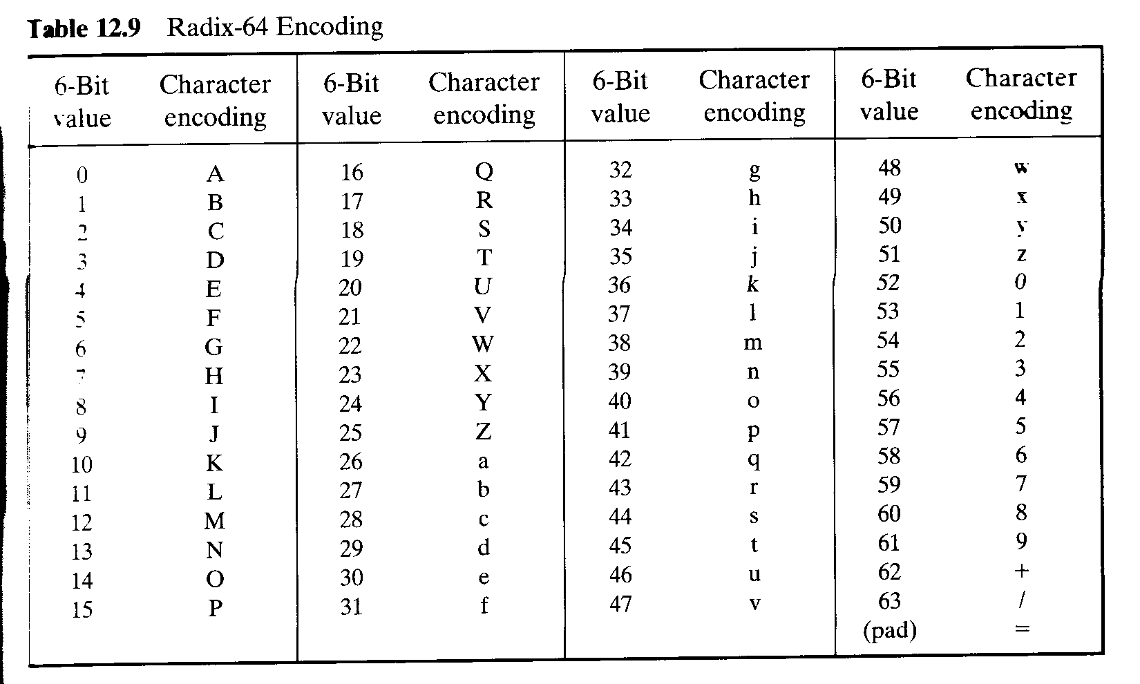
E-mail Compatibility

Slide 16
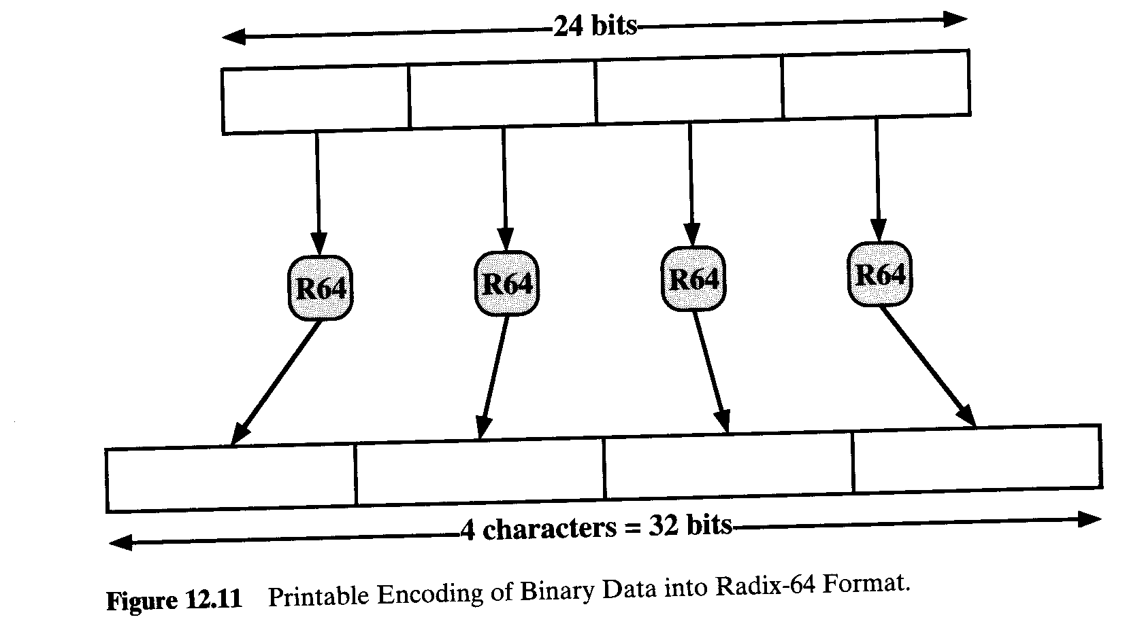
E-mail Compatibility

Slide 17
E-mail Compatibility
A typical overall effect of compression and expansion of a file of length X would be 1.33* 0.5* X=0.665*X.

Slide 18
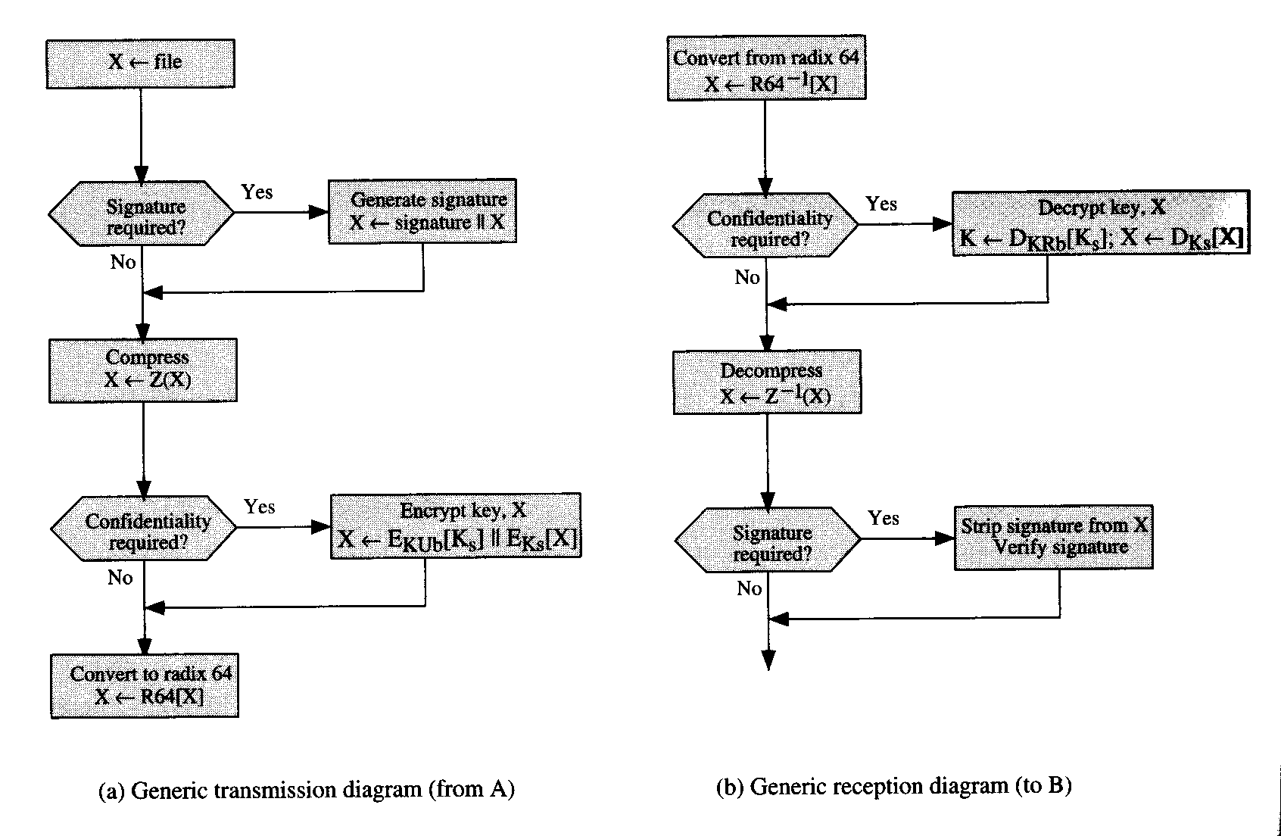
E-mail Compatibility
The figure shows the relationship among the four services. On transmission, if it is required, a signature is generated using a hash code of the compressed plaintext. Then the plaintext, plus signature if present, is compressed. Next, if confidentiality is required, the block is encrypted and prepended with the public-key-encrypted conventional encryption key. Finally the entire block is converted to radix-64 format. On reception, the incoming block is first converted back from radix-64 format to binary. Then, if the message is encrypted, the recovers the session key and decrypts the message. The resulting block is then decompressed. If the message is signed, the recipient recovers the transmitted hash code and compares it to its own calculation of the hash code.

Slide 19
Segmentation and Reassembly
E-mail facility often are restricted to a maximum message length. To accommodate this restriction, PGP automatically subdivides a message that is too large into segments that are small enough to send via e-mail. The segmentation is done after all of the other processing, including the radix-64 conversion. Thus, the session key component and signature component appear only once, at the beginning of the first segment. At the receiving end, PGP must strip off all e-mail headers and reassemble the entire original block before performing the steps.

Slide 20
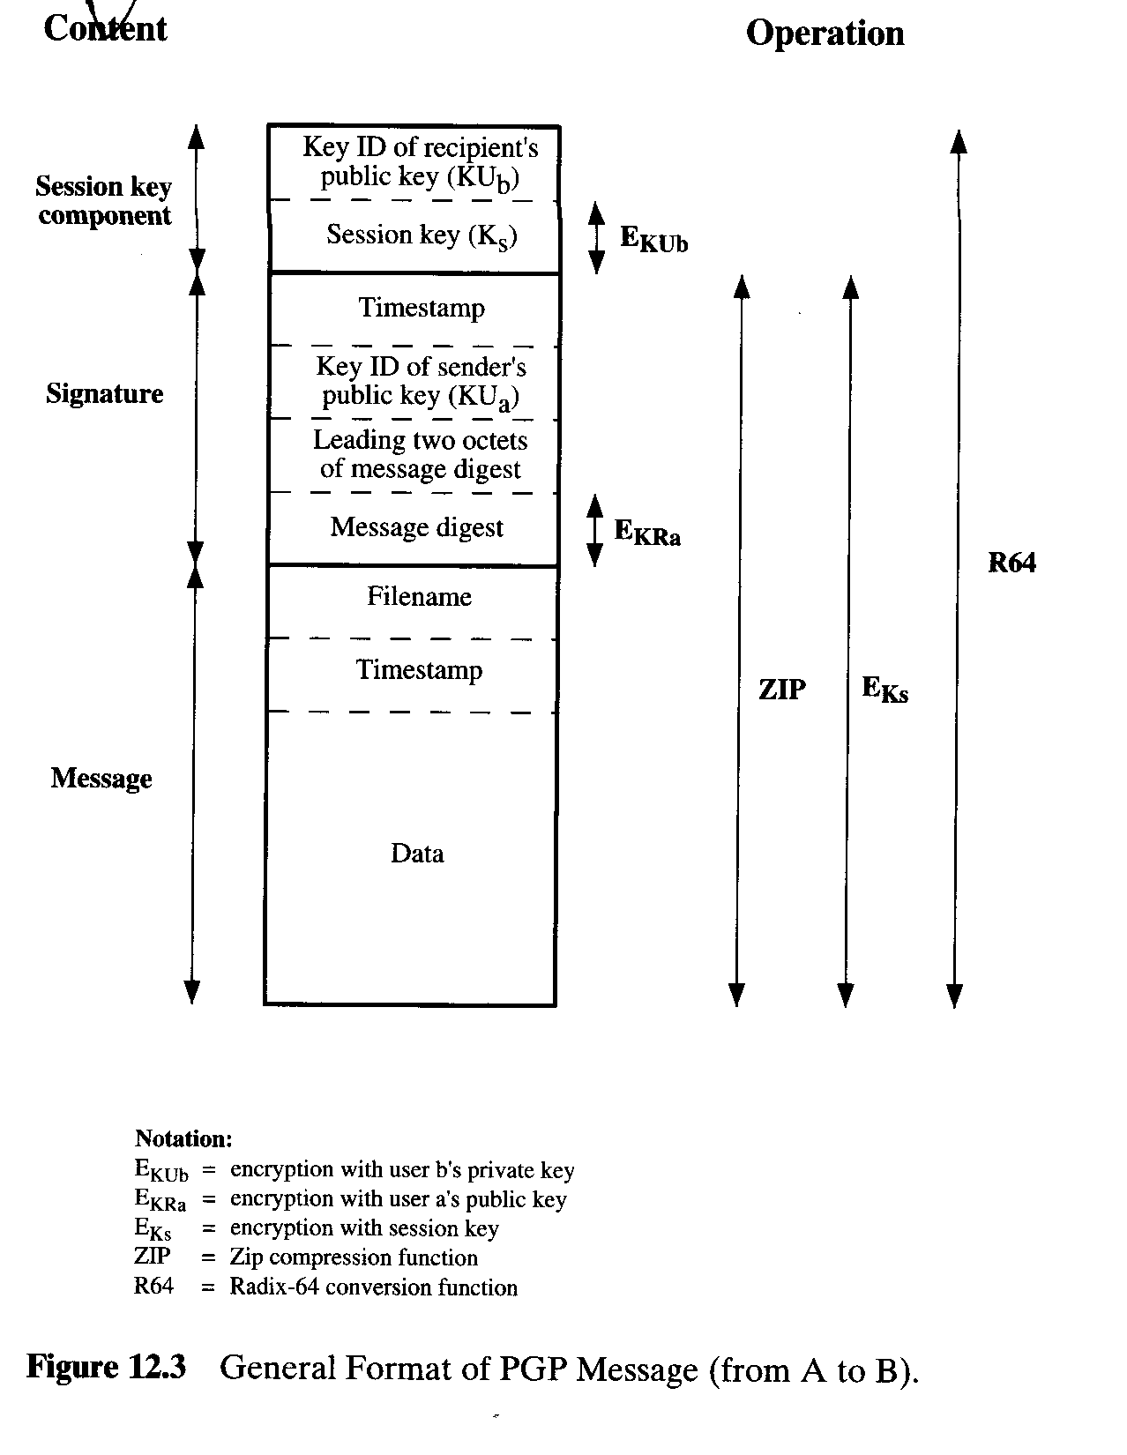
Segmentation and Reassembly

Slide 21
Cryptographic Keys and Key Rings
PGP makes use of four types of keys: one-time session conventional keys, public keys, private keys, and passphrase-based conventional keys. Three separate requirements can be identified with respect to these keys:
1. A means of generating unpredictable session keys is needed.
2. We would like to allow a user to have multiple public-key/private
key pairs. One reason is that the user may wish to change his or her
key pair from time to time. When this happens, any message in the
pipeline will be constructed with an obsolete key. Furthermore,
recipients will know only the old public key until an update reaches
them. In addition to the need to change keys over time, a user may
wish to have multiple key pairs at a given time to interact with
different groups of correspondents or simply to enhance security by
limiting the amount of material encrypted with any one key. The
upshot of all this is that there is not a one-to-one correspondence
between users and their public keys. Thus, some means is needed for
identifying particular keys.

Slide 22
Cryptographic Keys and Key Rings
3. Each PGP entity must maintain a file of its own public/private key
pairs as well as a file of public keys of correspondents.

Slide 23
Cryptographic Keys and Key Rings
Session Key Generation
Each session key is associated with a single message and is used only for the purpose of encrypting and decrypting that message. We assume the CAST-128 is used in the following discussion. The “plaintext” input to the random number generator, consisting of two 64-bit blocks, is itself derived from a stream of 128-bit randomized numbers. These numbers are based on keystroke input from the user. Both the keystroke timing and the actual keys struck are used to generate the randomized stream. Thus, if the user hits arbitrary keys at his or her normal pace, a reasonably “random” input will be generated. This random input is also combined with previous session key output from CAST-128 to form the key input to the generator. The result, given the effective scrambling of CSAT-128, is to produce a sequence of session keys that is effectively unpredictable.

Slide 24
Cryptographic Keys and Key Rings
Key Identifiers
Because the user may have multiple private/public keys, how the receiver knows which of its public keys was used to encrypt the session key. One simple solution would be to transmit the public key with the message. This scheme will work but it is unnecessarily wasteful of space. Another solution would be to associate an identifier with each public key that is unique at least within one user. That is, the combination of user ID and key ID would be sufficient to identify a key uniquely. Then only the much shorter key ID would need to be transmitted. This solution, however, raises a management and overhead problem: Key IDs must be assigned and stored so that both sender and receiver could map from key ID to public key.
The solution adopted by PGP is to assign a key ID to each public key that is, with very high probability, unique within a user ID. The key ID associated with each public key consists of its least significant 64 bits. That is the key ID of public key.

Slide 25
PGP Message Generation
A key ID is also required for the PGP digital signature. Because a sender may use one of a number of private keys to encrypt the message digest, the receiver must know which public key is intended for use. Accordingly, the digital signature component of a message includes the 64-bit key ID of the required public key. When the message is received, the receiver verifies that the key ID is for a public key that it knows for that sender and then proceeds to verify the signature.
A message consists of three components: the message component, a signature, and a session key component.
The message component includes the actual data to be stored or transmitted, as well as a filename and a timestamp that specifies the time of creation.

Slide 26
PGP Message Generation
The signature component includes the following component:
1. Timestamp: The time at which the signature was made.
2. Message digest: The 160-bit SHA-1 digest, encrypted with
the sender’s private signature key. The digest is calculated
over the signature timestamp concatenated with data portion
of the message component.
3. Leading two octets of message digest: to enable the receive
to determine if the correct public key was used to decrypt the
message digest for authentication, by comparing this plaintext
copy of the first two octets with the first two octets of the
decrypted digest.
4. Key ID of sender’s public key: Identifies the public key that should
be used to decrypt the message digest and hence, identifies the
private key that was used to encrypt the message digest.

Slide 27
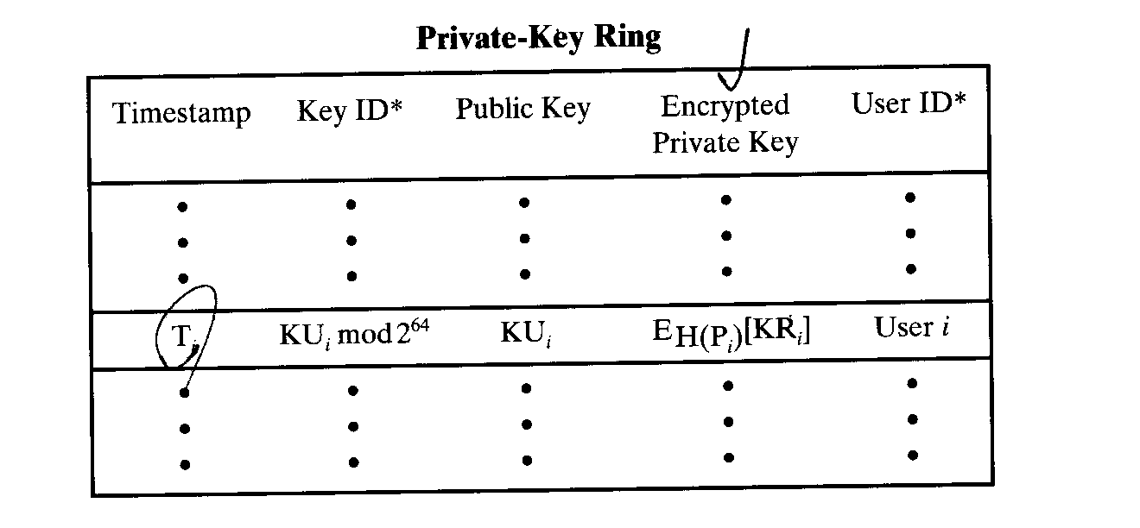
Cryptographic Keys and Key Rings
Key Ring
The figure shows the general structure of a private-key ring. We can view the ring as a table, in which each row represents one of the public/private key pairs owned by this user. Each row contains the following entries:
Timestamp: The date/time when this key pair was generated.
Key ID: The least significant 64 bits of the public key for this entry.
Public key: The public-key portion of the pair.
Private key: the private-key portion of the pair.
User ID: Typically, this will be the user’s e-mail address.

Slide 28
Cryptographic Keys and Key Rings
The private-key ring can be indexed by either User ID or Key ID. Although it is intended that the private-key ring be stored only on the machine of the user that created and owns the key pairs, and that it be accessible only to that user, it makes sense to make the value of the private key as secure as possible. Accordingly, the private key itself is not stored in the key ring. Rather, this key is encrypted using CSAT-128. The procedure as as following:
1. The user selects a passphresa to be used for encrypting private key.
2. When the system generates a new public/private key pair using
RSA, it asks the user for the passphrase. Using SHA-1, a 160-bit
hash code is generated form the passphrase, and the passphrase is
discarded.
3. The system encrypts the private key using CAST-128 with the 128
bits of the hash code as the key. The hash code is then discarded,
and the encrypted private key is stored in the private-key ring.

Slide 29
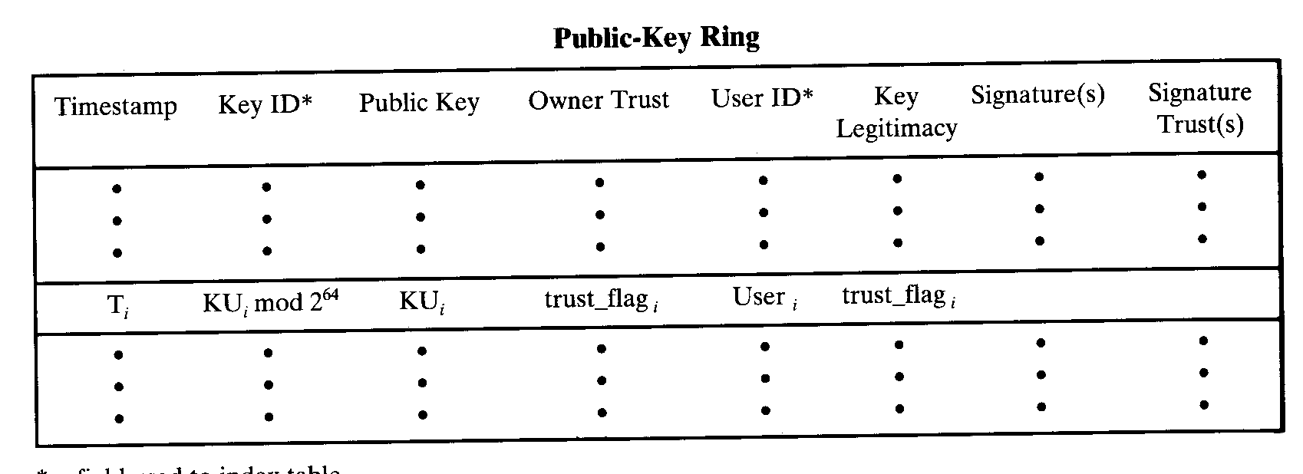
Cryptographic Keys and Key Rings
The figure shows the structure of a public-key ring. This data structure is used to store public keys of other users that are known to this user. For the moment, let us ignore some fields shown in the table and describe the following fields:
Timestamp: The date/time when this entry was generated.
Key ID: The least significant 64 bits of the public key for this entry.
Public key: The public key for this entry.
User ID: The owner of this key.

Slide 30
PGP Message Generation
Now let’s consider that message transmission and assume that the message is to be both signed and encrypted. The sending PGP entity performs the following steps:
1. Signing the message
a. PGP retrieves the sender’s private key from the private-key ring
using your_userid as an index. If your_userid was not provided in
the command, the first private key on the ring is retrieved.
b. PGP prompts the user for the passphrase to recover the
unencrypted private key.
c. The signature component of the message is constructed.
2. Encrypting the message
a. PGP generates a session key and encrypts the message.
b. PGP retrieves the recipient's public key from the public-key ring
using her_userid as an index.
c. The session key component of the message is constructed.

Slide 31
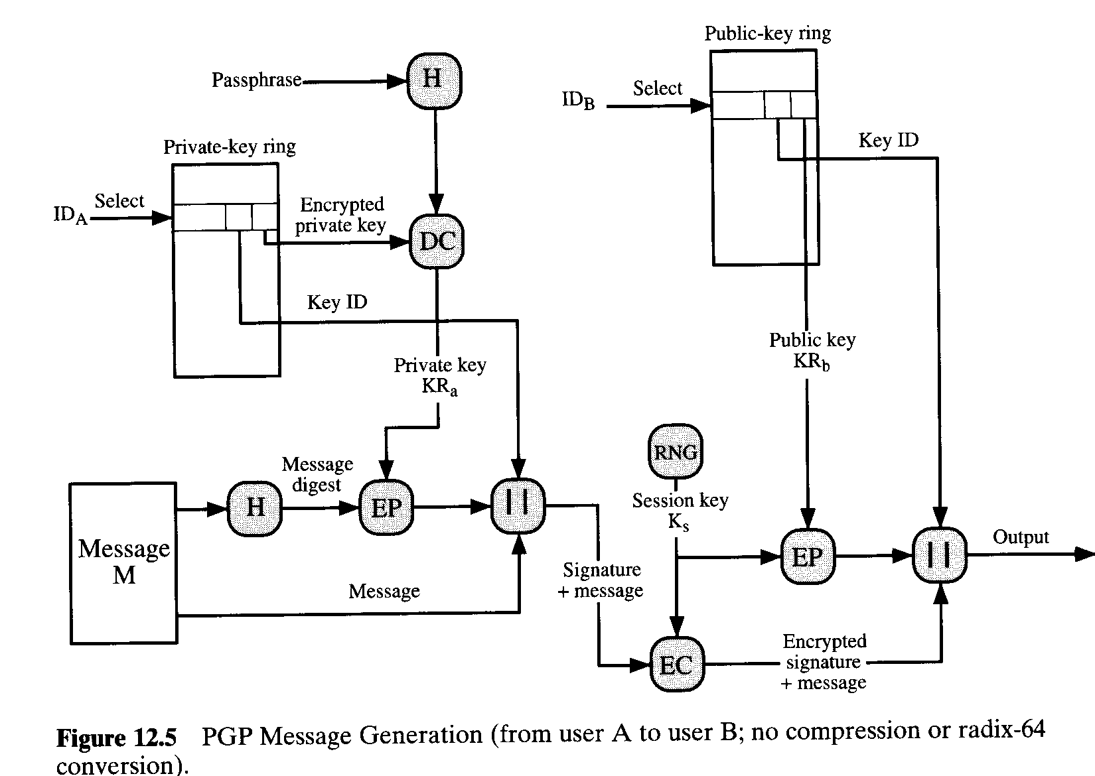
PGP Message Generation

Slide 32
PGP Message Reception
The receiving PGP entity performs the following steps
1. Decrypting the message
a. PGP retrieves the receiver’s private key from the private-key ring,
using the Key ID field in the session key component of the
message as an index.
b. PGP prompts the user for the passphrase to recover the
unencrypted private key.
c. PGP then recovers the session key and decrypts the message.
2. Authenticating the message
a. PGP retrieves the sender’s public key from the public-key ring,
using the Key ID field in the signature key component of the
message as an index.
b. PGP recovers the transmitted message digest.
c. PGP computes the message digest for the received message and
compares it to the transmitted message digest to authenticate.

Slide 33
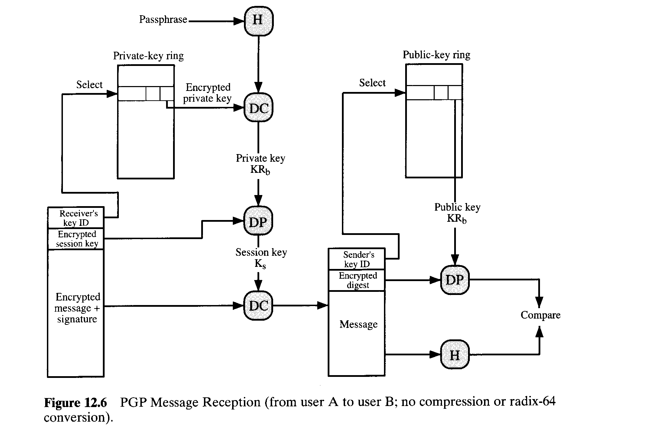
PGP Message Reception

Slide 34
Public-Key Management
Approaches to Public-Key Management
A number of approaches are possible for minimizing the risk that a user’s public-key ring contains false public keys. Suppose that A wishes to obtain a reliable public key for B. The following are some approaches that could be used:

Slide 35
Public-Key Management
1.Physically get the key from B. B could store her public key on a floppy disk and hand it to A. A could then load the key into his system from the floppy disk. This is a very secure method but has obvious practical limitations.
2.Verify a key by telephone. If A can recognize B on the phone, A could call B and ask her to dictate the key, in radix-64 format, over the phone. As a more practical alternative, B cloud transmit her key in an e-mail message to A. A could have PGP generate a 160-bit SHA-1 digest of the key and display it in hexadecimal format; this is referred to as the “fingerprint” of the key. A could then call B and ask her to dictate the fingerprint over the phone.
3. Obtain B’s public key from a mutual trusted individual D. For this purpose, the introducer, D, creates a signed certificate. The certificate includes B’s public key, the time of creation of the key, and a validity period for the key. D generates an SHA-1 digest of this certificate, encrypts it with her private key, and attaches the signature to the certificate. Because on;y D could have created the signature, no one else can create a false public key and pretend that it is signed by D. This signed certificate could be sent directly to A by B or D, or could be posted on the bulletin board.
4. Obtain B’s public key from a trusted certifying authority. Again, a public-key certificate is created and signed by the authority. A could then access the authority, providing a user name and receiving a signed certificate.

Slide 36
Public-Key Management
The Use of Trust
Although PGP does not include any specification for establishing certifying authorities or for establishing trust, it does provide a convenient means of using trust, associating trust with public keys, and exploiting trust information.
The basic structure is as follows. Each entry in the public-key ring is a public-key certificate. Associated with each such entry is a key legitimacy field that indicates the extent to which PGP will trust that this is a valid public key for this user; the higher the level of trust, the stronger is the binding of this user ID to this key. This field is computed by PGP. Also, associated with the entry are zero or more signatures that the key ring owner has collected that sign this certificate. In turn, each signature has associated with it a signature trust field that indicates the degree to which this PGP user trusts the signer to certify public keys. The key legitimacy field is derived from the collection of signature trust fields in the entry, and an owner trust field is included that indicates the degree to which this public key is trusted to sign other public-key certificates; this level of trust is assigned by the user.

Slide 37
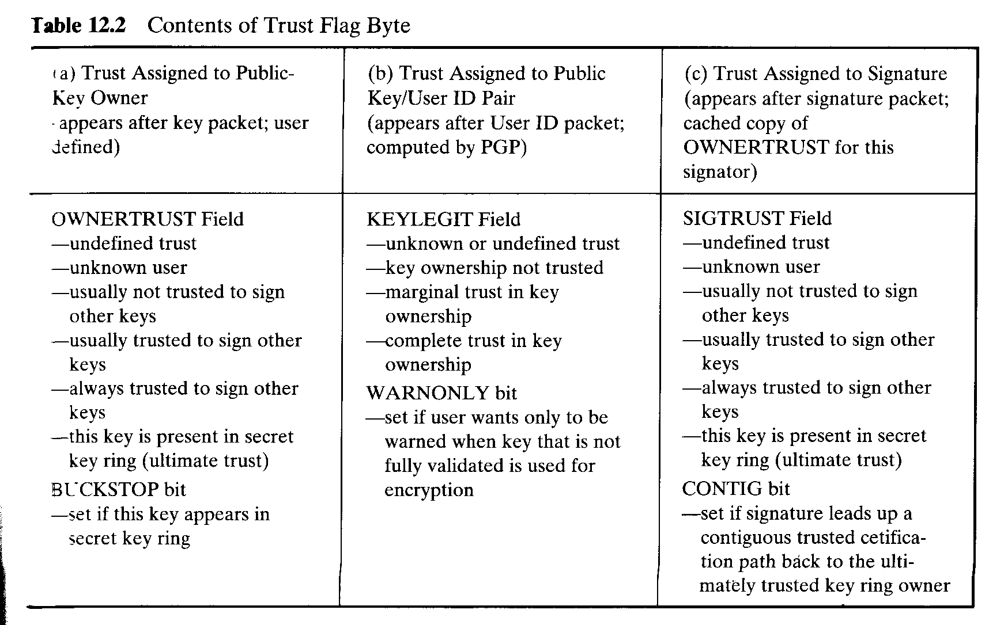
Public-Key Management

